Slide 1

Applied Data Analyst Capstone
Gabriel Valverde
24/09/2022
https://github.com/gabriel-jap/Data_Analysis

Slide 2
Index
Executive Summary
Introduction
Methodology
Analysis
Conclusion
Appendix

Slide 3

EXECUTIVE SUMMARY
In order to finish the course of Data Science by Coursera. I had to examine information about the changes in the IT field and share my Insights.
The Data was collected by looking at Job Postings, training portals and surveys and enriched with Web Scrapping to have a better comprehension of the situation

Slide 4
Introduction
A global IT and business consulting services firm that is known for their expertise in IT solutions and their team of highly experienced IT consultants, in order to keep pace with changing technologies and remain competitive, tasked me to analyzes data to help identify future skill requirements.

Slide 5
Methodology

Slide 6




METHODOLOGY: Data
The data was provided by the GitHub API and backed up with tables from Wikipedia’s articles and a Dataset from Kaggle.

Slide 7
GitHub API: Selecting Features
https://github.com/gabriel-jap/Data_Analysis/blob/main/Semana%201/Collecting_Jobs_data_Using_API-Questions.ipynb
See listings of jobs by Language
See listings of jobs by location
Full Response of the request API
C
C#
C++
Java
JavaScript
Python
Scala
Oracle
SQL Server
MySQL Server
PostgreSQL
MongoDB
Los Angeles
New York
San Francisco
Washington DC
Seattle
Austin
Detroit

Slide 8
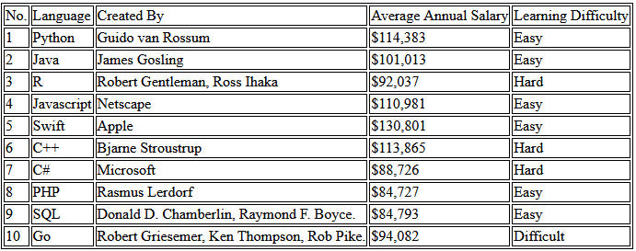

Wikipedia: Web scraping
https://github.com/gabriel-jap/Data_Analysis/blob/main/Semana%201/Web-Scraping-Lab.ipynb
From: https://cf-courses-data.s3.us.cloud-object-storage.appdomain.cloud/IBM-DA0321EN-SkillsNetwork/labs/datasets/Programming_Languages.html

Slide 9
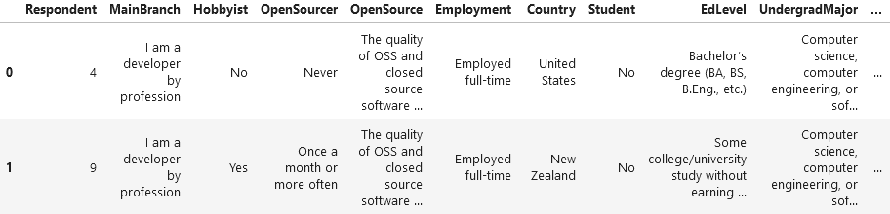
Survey: Knowing our Data
https://github.com/gabriel-jap/Data_Analysis/blob/main/Semana%201/M1ExploreDataSet-lab.ipynb
With more than 85 columns 11552 rows of information were recorded to process, from personal information to information about their actual knowledge and desired knowledge, a lot of information were recorded.
From which, me will be interested in the annual payment and the language they use, and the desire of knowing another language

Slide 10
Survey: Wrangling Information
https://github.com/gabriel-jap/Data_Analysis/blob/main/Semana%202/M2DataWrangling-lab.ipynb
Create a column “NormalizedAnnualCompensation” by multiplying the monthly and weekly salary in order to get an annual Compensation to all the records
154 Duplicates were erased
32 missing values in the column “WorkLoc” filled with the most common value “Office”

Slide 11


METHODOLOGY: Analytics
It was used Python to realize some basic EDA such as:
Distribution of payment Median of payment Information about Age Information about payment (prior to eliminate out layer)
Then, with Python and SQL, graphics were made to show the characteristics and trends among the records
https://github.com/gabriel-jap/Data_Analysis/blob/main/Semana%204/M4DataVisualization-lab.ipynb
https://github.com/gabriel-jap/Data_Analysis/blob/main/Semana%203/M3ExploratoryDataAnalysis-lab.ipynb

Slide 12
METHODOLOGY: Dashboard
https://dataplatform.cloud.ibm.com/dashboards/ca7c92b1-ce19-4d07-aa6c-df96a3a5a1bb/view/710aa00513eb0ac05fe6f2e4079c2f0f28612308b0bb820a80877b490a607397a83b1b96c82a4a5cd9195131f5ee47519d
In Order to create an interactive Dashboard I use IBM’s Cognos to see:
The most used and most looking for:
Language
Platform
Database
Web frame
The respondent by:
Gender
Country
Age
Formal Education

Slide 13
Analytics

Slide 14
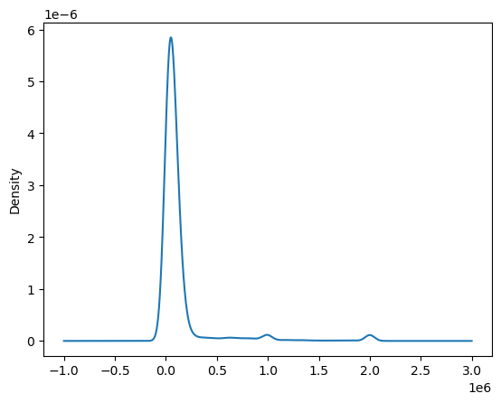
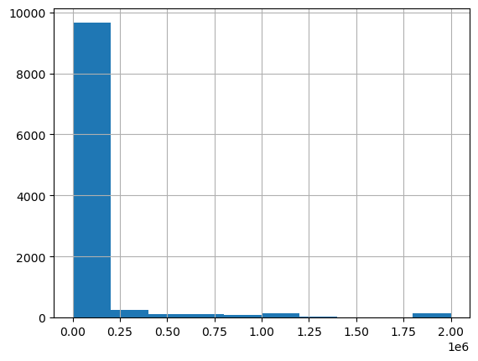
Analytics:
EDA
Here we see the Density of the Compensation. We see an almost homogeneous low level, with little spikes.
The respondents come from similar positions or payment levels.

Slide 15
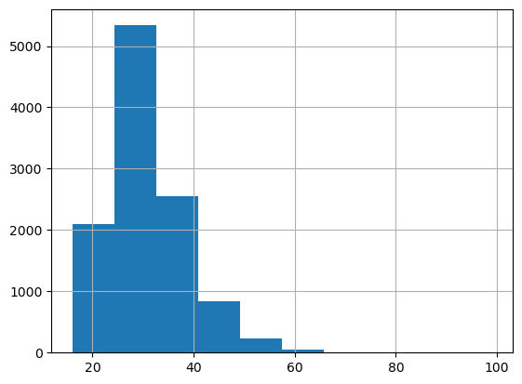
Analytics:
EDA
This is the density of respondents by Age, and we see a how the ages are mostly spread between 20 and 40

Slide 16
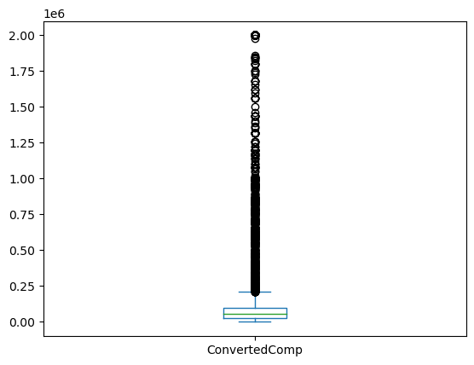
Analytics:
EDA
About Annual compensation we confirm how similar the payments of the majority are, and a widespread group but small group with above salary

Slide 17
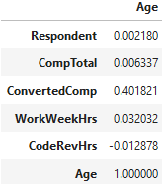
Analytics:
EDA
About the correlation between Age and salary, we see a positive correlation, but not a strong one.

Slide 18
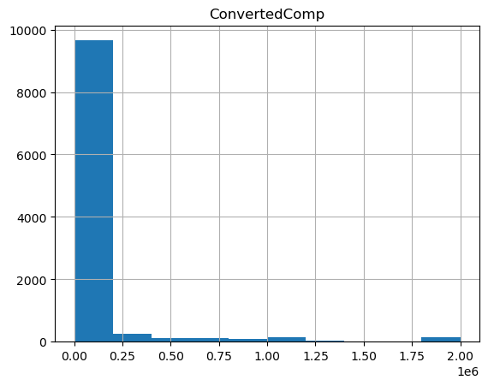
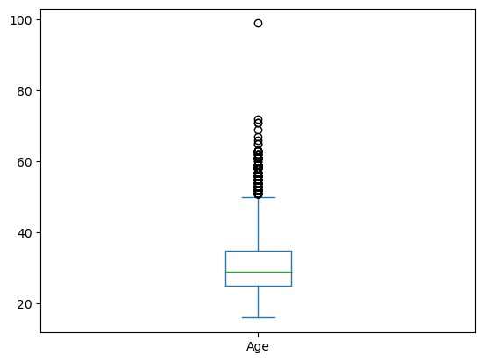
Analytics:
SQL EDA
With SQL, we how the respondents come mostly from low level developers with ages from under 20 to 50.

Slide 19
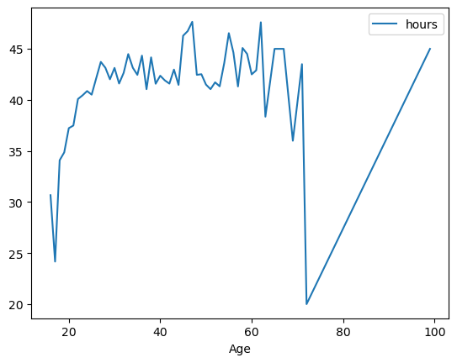
Analytics:
SQL EDA
We see that the group from ages between 20 and 50 works around 35-50 hours a week.

Slide 20
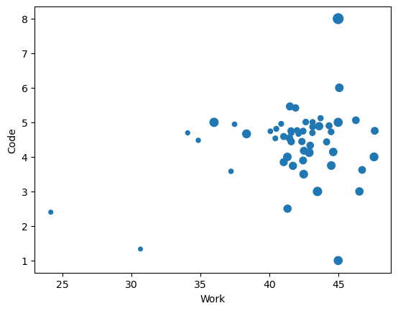
Analytics:
SQL EDA
We see that mainly the group from ages between 35 and 45 do monthly Code Review, spending from 3 to 6 hours doing it.

Slide 21
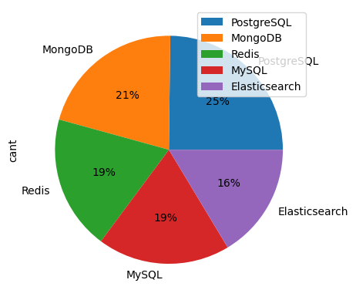
Analytics:
SQL EDA
From the survey, we see how evenly the top 5 most desired to learn Databases are with just a 6% of difference between PostgreSQL and MySQL

Slide 22
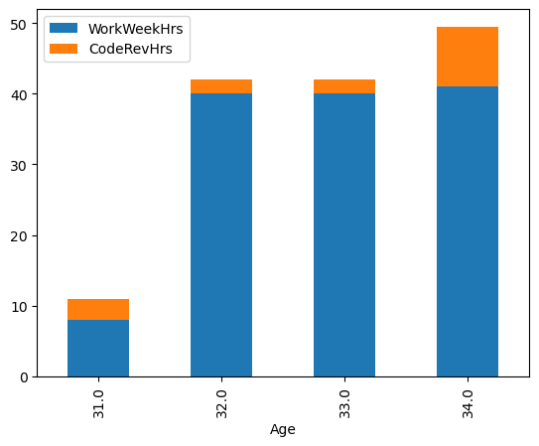
Analytics:
SQL EDA
Even the group who does code review, it's not a huge part of its workload

Slide 23
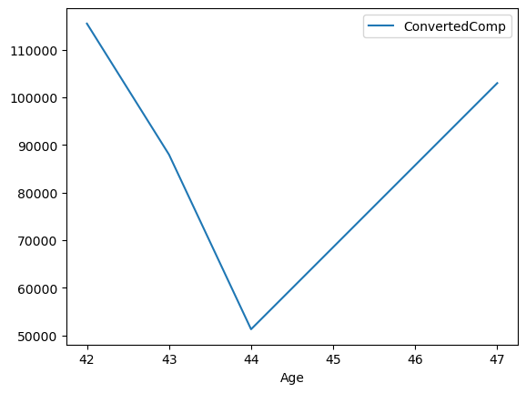
Analytics:
SQL EDA
Here we see the drop of Annual compensation as Age goes on

Slide 24
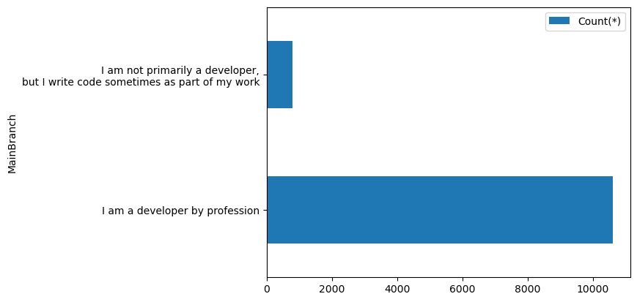
Analytics:
SQL EDA
We can see the majority of the respondents come from developers

Slide 25
Analytics: Cognos

Slide 26
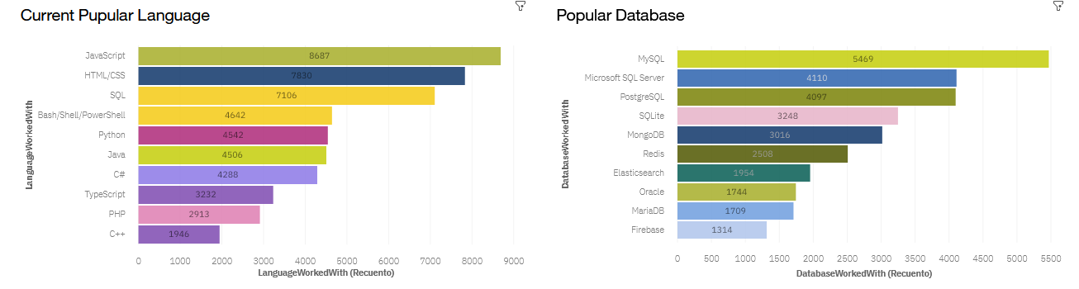
Analytics:
Cognos
Actual Fields
we can see haw the actual field is predominantly of Web Languages, and a big popularity of MySQL

Slide 27
Analytics:
Cognos
Actual Fields
we can see haw the actual field is predominantly of Web Languages, and a big popularity of MySQL

Slide 28
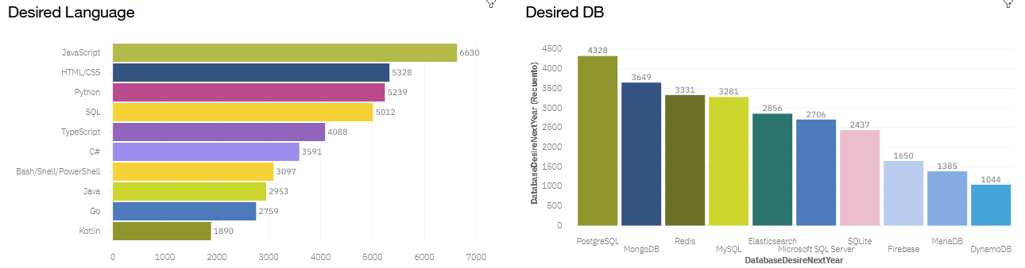
Analytics:
Cognos
Fields of interest
However, we can see a shift with an upcoming of python and PostgreSQL as well as other CB

Slide 29
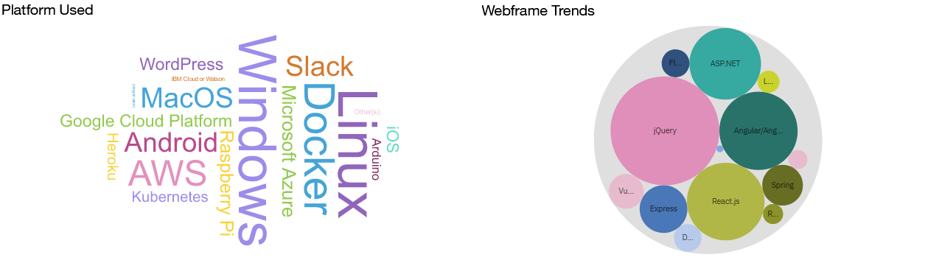
Analytics:
Cognos
Actual Tools
Nowadays, windows has a strong presence in the technology field, only competing with Linux.
Different with JQuery who compete closely with Angular, React and ASP.NET.

Slide 30
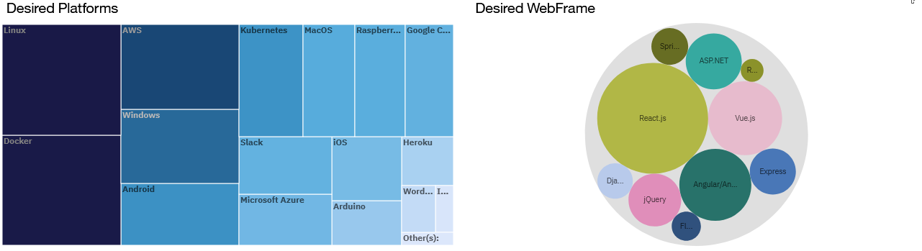
Analytics:
Cognos
Tools of interest
Then Again, the respondent shows a shift in the field since the future in the rivalry in Platforms seems to be towards Python.
The same happens with the WebFrames, Angular seems to be a brighter future than his rivals

Slide 31
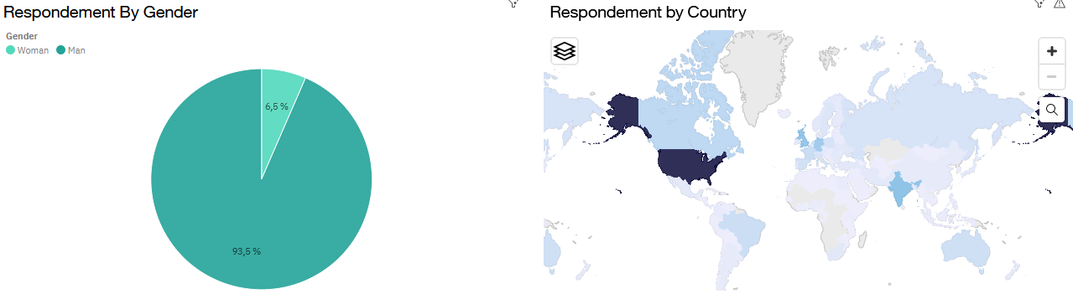
Analytics:
Cognos
About the respondents
About the respondents, we see a majority of males of English-Speaking countries plus, some big countries like India, Russia, and Brazil

Slide 32
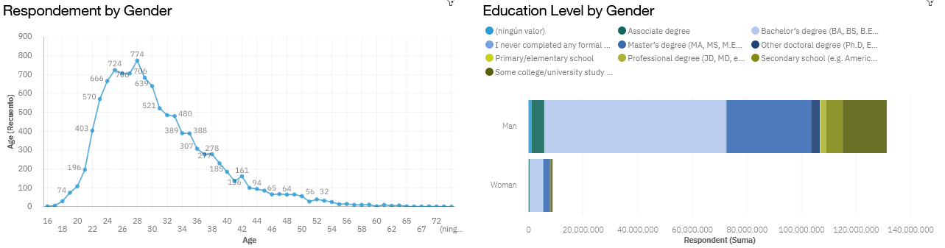
Analytics:
Cognos
About the respondents
The respondents, seems to be 24-32 years old with a bachelor or some with masters in the field

Slide 33
Discussion
I conclude that the current IT environment is really homogeneous, with people almost exclusively under 40 years, with same payment across the different places.
Then we see there is a Majority of young male population just with a Bachelor Degree
At last, we can expect a steady use of Javascript, a more popular Python and Linux, contrasting with a more diverse DataBase and Webframe environment.

Slide 34
Conclusion
Male from -40 and with a Bachelor were the most engaged with the survey
There is a close difference between the salary of the registered
Javascript seems to keep the position as the most common language
The Database, WebFrame, and Plataform environment tends to be more diverse

Slide 35
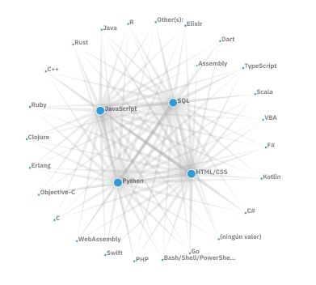
Appendix
Something to take account is that the main interest of those who use the popular languages is to learn other popular languages, being SQL and Python the most strong relationship

